Slide 1
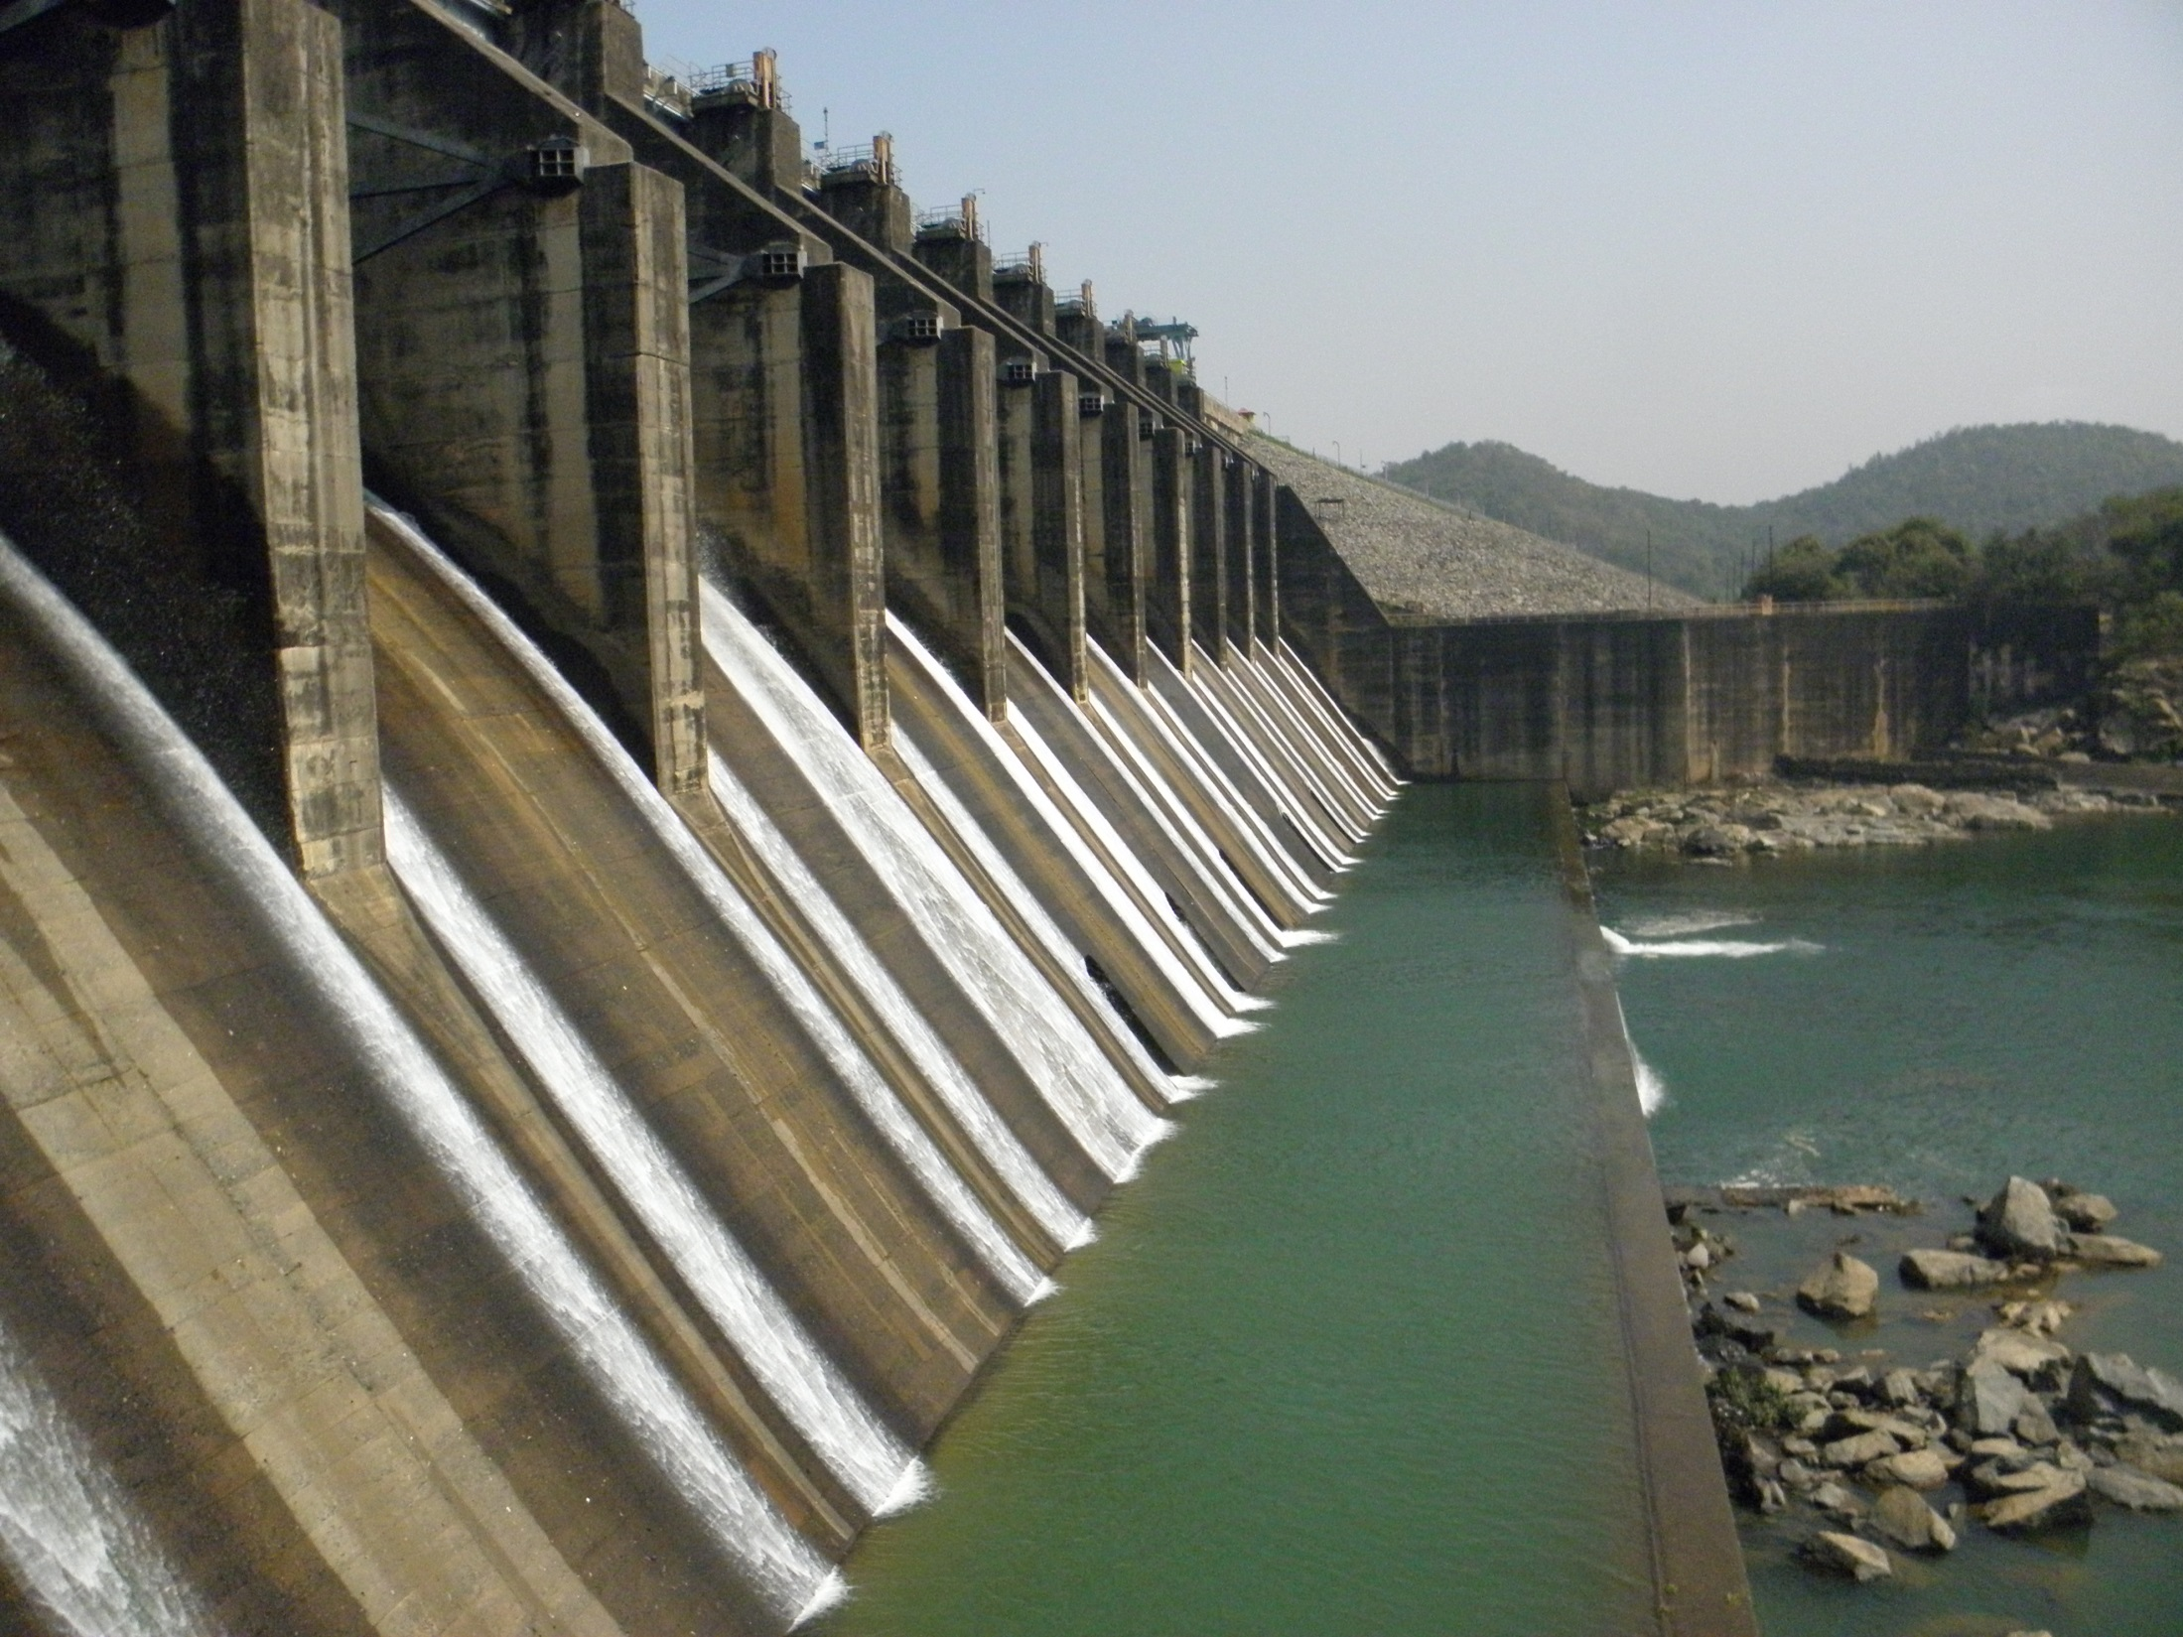
AN OVERVIEW OF INTEGRATED WATER RESOURCES MANAGEMENT IN DVC
PREPARED BY
DIPANKAR CHAUDHURI
SE(CIVIL), DVC
GUIDED BY
S. B. PANDEY
DCE(CIVIL), DVC

Slide 2
HISTORY OF DAMODAR RIVER VALLEY
THE RECORDS OF THE BENGAL GOVERNMENT FOR THE PERIOD 1852-1923 SHOW THAT THE RIVER BREACHED ITS BANKS FREQUENTLY. THE GOVERNMENT WAS FORCED TIME AND AGAIN TO TAKE UP DIFFERENT PLANS FOR FLOOD CONTROL WORKS. NOTABLY LARGE FLOODS CAUSED WIDE SPREAD DAMAGE IN THE YEARS 1823, 1840, 1877, 1913, 1935, 1939, 1941, AND 1943.
FLOOD CONTROL BY MEANS OF RESERVOIRS WAS CONSIDERED AS EARLY AS 1863. BRITISH ENGINEERS WISHING TO LOCATE DAM SITES SURVEYED ONE RESERVOIR SITE IN JANUARY 1864.
IN 1902 A RESERVOIR SITE WAS PROPOSED AT BARAKAR ABOVE THE CONFLUENCE OF THE BARAKAR AND USRI RIVERS. AFTER THE SEVERE FLOOD OF 1913, A LARGE RESERVOIR WAS PROPOSED ONCE MORE FOR THAT SITE.
IN 1919, THE IDEA OF USING MULTIPLE RESERVOIRS WAS CONCEIVED. THE IDEA WAS TO USE THREE DAMS – ONE ON DAMODAR RIVER, ONE ON THE BARAKAR RIVER AND ONE ON THE USRI RIVER.
CONSTRUCTION OF DAMODAR CANAL (ANDERSON) BEGAN IN 1926 AND COMPLETED IN 1933.
THE GOVERNOR OF BENGAL SET UP THE DAMODAR FLOOD ENQUIRY COMMITTEE IN 1943 & ITS REPORT (AUG 1944) SUGGESTS THE CREATION OF AN AUTHORITY SIMILAR TO THAT OF TVA.
DVC WAS FORMED IN THE YEAR 1948 BY THE ACT OF CONSTITUENT ASSEMBLY OF GOVERNMENT OF INDIA

Slide 3
FUNCTIONS OF THE CORPORATION
THE PROMOTION AND OPERATION OF SCHEMES FOR IRRIGATION, WATER SUPPLY AND DRAINAGE
THE PROMOTION AND OPERATION OF SCHEMES FOR THE GENERATION, TRANSMISSION AND DISTRIBUTION OF ELECTRIC ENERGY, BOTH HYDRO-ELECTRICAL AND THERMAL
THE PROMOTION AND OPERATION OF SCHEMES FOR FLOOD CONTROL IN THE DAMODAR RIVER AND ITS TRIBUTARIES AND THE CHANNELS, IF ANY, EXCAVATED BY THE CORPORATION IN CONNECTION WITH THE SCHEME AND FOR THE IMPROVEMENT OF FLOW CONDITIONS IN THE HOOGHLY RIVER,
THE PROMOTION AND CONTROL OF NAVIGATION IN THE DAMODAR RIVER AND ITS TRIBUTARIES AND CHANNELS, IF ANY
THE PROMOTION OF AFFORESTATION AND CONTROL OF SOIL EROSION IN THE DAMODAR VALLEY, AND
THE PROMOTION OF PUBLIC HEALTH AND THE AGRICULTURAL, INDUSTRIAL, ECONOMIC AND GENERAL WELL-BEING IN THE DAMODAR VALLEY AND ITS AREA OF OPERATION.

Slide 4
CORPORATE OBJECTIVES
GENERATE MORE POWER AT LOWEST POSSIBLE COST
TRANSMIT, DISTRIBUTE AND SUPPLY RELIABLE AND QUALITY POWER
ADOPTION OF EFFICIENT INDUSTRIAL, COMMERCIAL AND HUMAN RESOURCE MANAGEMENT PRACTICES
OPTIMUM UTILIZATION OF AVAILABLE WATER RESOURCES AND HARNESSING THE REMAINING POTENTIAL OF THE BASIN TO THE EXTENT POSSIBLE
TO FORTIFY MEASURES FOR ENVIRONMENTAL PROTECTION AT PLANT LEVELS AND TO CONTINUE WITH THE EFFECTIVE ECO-CONSERVATION ACTIVITIES IN THE VALLEY AREA.
STRENGTHENING OF SOCIO-ECONOMIC DEVELOPMENT FOR THE INHABITANTS OF NEIGHBORING VILLAGES OF THE MAJOR PROJECTS

Slide 5
THE TENNESSEE VALLEY AUTHORITY (TVA) - A PARTIAL MODEL FOR THE DAMODAR VALLEY CORPORATION (DVC)
BRIEF COMPARISON
 | UNIT | TENNESSEE | DAMODAR
CATCH AREA | Sq. Mile | 40,200 | 8,500
RIVER LENGTH | Miles | 652 | 336
FOREST COVER | Acres | 13,000,000 | 6,000,000
 |  | (1930) | (1948)
MEAN YEARLY R/F | Inches | 51 | 45
MEAN YLY RUNOFF | % of rainfall | 42 | 35
DAM (MAJOR) | Nos. | 39 | 5
POPULATION | Nos. | 2,800,000 (1930) | 10,720,485 (1971)
 |  |  | 14,076,399 (1991)

Slide 7
DAMODAR VALLEY RESERVOIR REGULATION COMMITTEE (DVRRC)
COMMITTEE IS FRAMED COMPRISING OF THE MEMBERS OF THE STAKE HOLDER STATES I.E. JHARKHAND AND WEST BENGAL, AS WELL AS MEMBERS OF DVC AND CENTRAL WATER COMMISSION - A PIVOT BODY OF GOVERNMENT OF INDIA.
ROLE OF COMMITTEE IS FRAMING OF POLICY (OPERATION MANUAL) AND TO REGULATE THE OPERATION OF ALL THE RESERVOIRS INCLUDING ALLOCATION OF WATER TO DIFFERENT AGENCIES FOR DIFFERENT USES.

Slide 8
MAJOR ACTIVITIES TAKEN UP BY DVC
INSTALLATION OF 39 AUTOMATIC RAIN GAUGE STATIONS
MODIFICATION OF THE EXISTING OPERATIONAL GUIDE CURVES
RESERVOIR MANAGEMENT
FLOOD FORECAST MANAGEMENT
HYDRAULIC DATA MANAGEMENT
CREATION OF STORAGE
DE-SILTATION WORK
PISCICULTURE
MASTER PLAN
DRIP
ENVIRONMENTAL MANAGEMENT
SOIL CONSERVATION
DAM BREAK ANALYSIS
EAP (EMERGENCY ACTION PLAN) & DMP (DISASTER MANAGEMENT PLAN)
REHABILATION AND RE-SETTLEMENT (R & R)
SEDIMENTATION SURVEY OF RESERVOIRS
SOCIAL INTEGRATION PROGRAMME

Slide 9
MUNICIPAL & INDUSTRIAL WATER SUPPLY
SUPPLYING WATER TO ABOUT 170 MUNICIPAL & INDUSTRIAL AGENCIES FROM MACKLUKXIGUANGE NEAR DALTANGUANGE IN JHARKHAND TO PANAGARH IN WB.
MAIN INDUSTRIAL CONSUMERS
COAL INDIA
STEEL PLANTS
THERMAL PLANTS
RAILWAYS
CEMENT FACTORIES
HFCL, DPL, STPS ETC.
MAIN DOMESTIC CONSUMERS
JHARIA WATER BOARD
DHANBAD WATER WORKS
ASANSOL RANIGUNGE & DURGAPUR MUNICIPALITIES
PUBLIC HEALTH ENGINEERING DEPARTMENTS (JHARKHAND & W. BENGAL) ETC.

Slide 10
MUNICIPAL AND INDUSTRIAL WATER WITHDRAWAL
Withdrawal in MCM/Day

Slide 11
IRRIGATION AREA
WEST BENGAL
Kharif Irrigation potential: 9,73,000 acre (3,93,763 hectare)
Rabi irrigation potential : 55,000 acre (22,258 hectare)
JHARKHAND
 | Kharif | Rabi | Total
 | Hectare | Hectare | Hectare
Check dams (16,882) | 64,748 |  | 64,748
Small Reservoirs
Jamunia | 1458 |  | 1,458
Charwa | 405 |  | 405
Gonda | 931 |  | 931
Proposed
Konar Reservoir | 47,849 | 14,074 | 61,923
Balpahari Reservoir | 40,468 |  | 40,468
 |  |  | 1,69,933

Slide 16
A VIEW OF DAMODAR VALLEY RESERVOIR STORAGE AND FLOOD MODERATION
---------------------------------------------------------------------------------------------------------------------------------
Flood Live Total Flood Moderation Capacity
Storage Storage Storage Combined Peak Moderated
Inflow Outflow
(MCM) (Cumec)
----------------------- ---------------------------------------------------------------------------------------------------------
Original Plan 3579 2838 7009 28321 7085
1st Stage of 1851 1318 3812 18420 7085
DVC Dams
Achieved 1116 1318 3077 17003 7085
in 1ST stage
Current 971 926 2206 14169 3684
position
Loss in % 13 30 28 NA NA
------------------------------------------------------------------------------------------------------------------------------

Slide 18
LOSS OF CAPACITY IN %
 | Maithon | Panchet | Tilaiya | Konar
Dead | 54.85 | 55.08 | 46.81 | 41.67
Live | 27.35 | 32.94 | 40.76 | 20.81
Flood | 12.57 | 13.20 | 7.30 | 32.14
Gross | 27.36 | 28.24 | 31.60 | 26.41

Slide 21
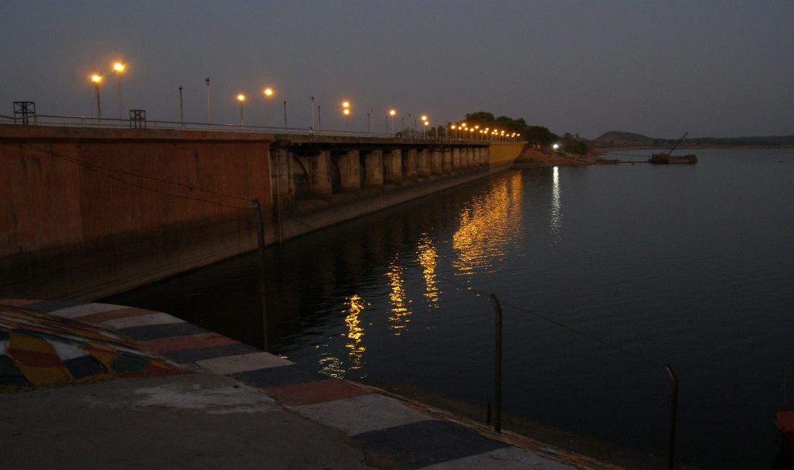
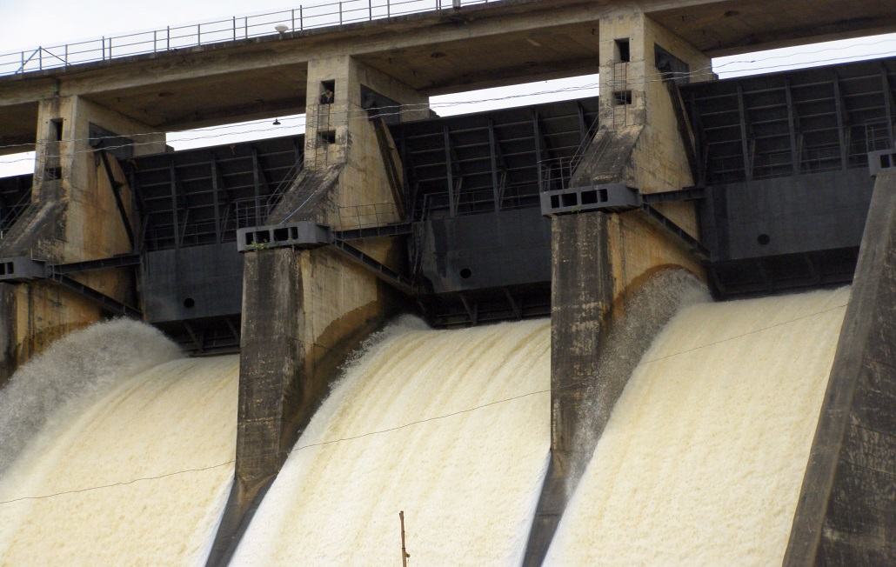
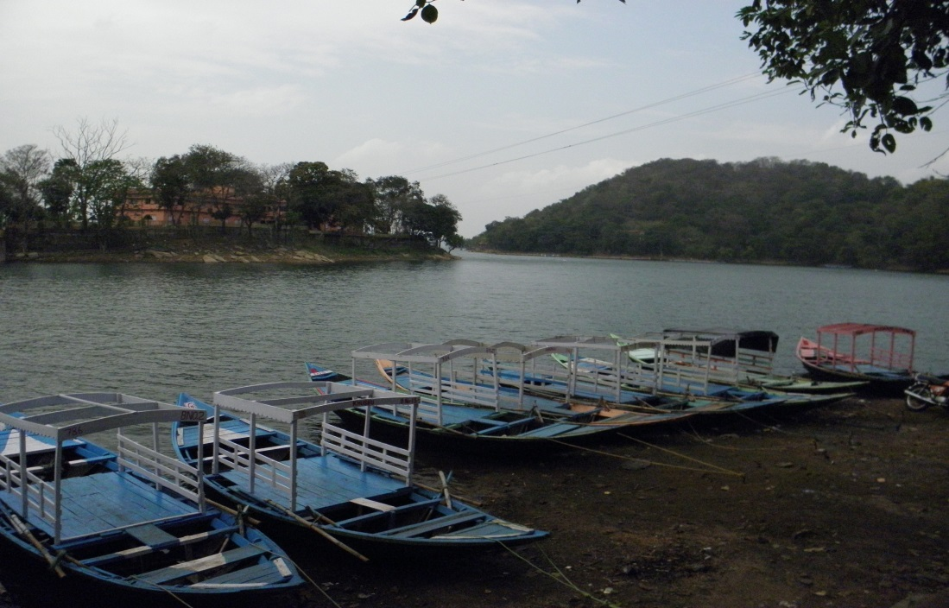
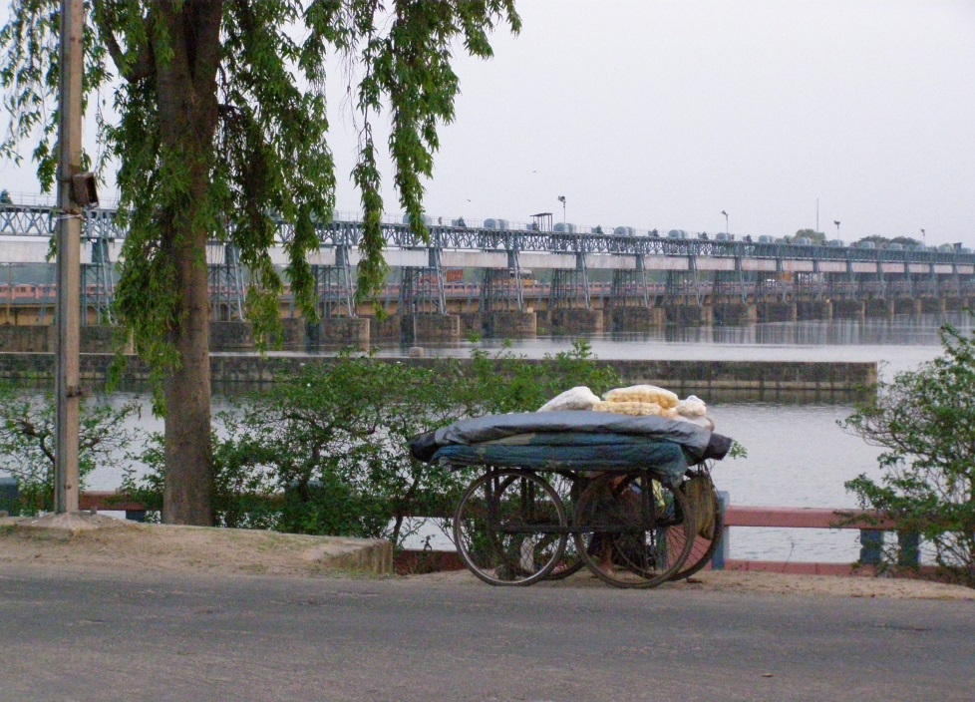
TILAIYA DAM
KONAR FLOOD RELEASE
TOURISM AT MAITHON DAM
DURGAPUR BARRAGE

Slide 22
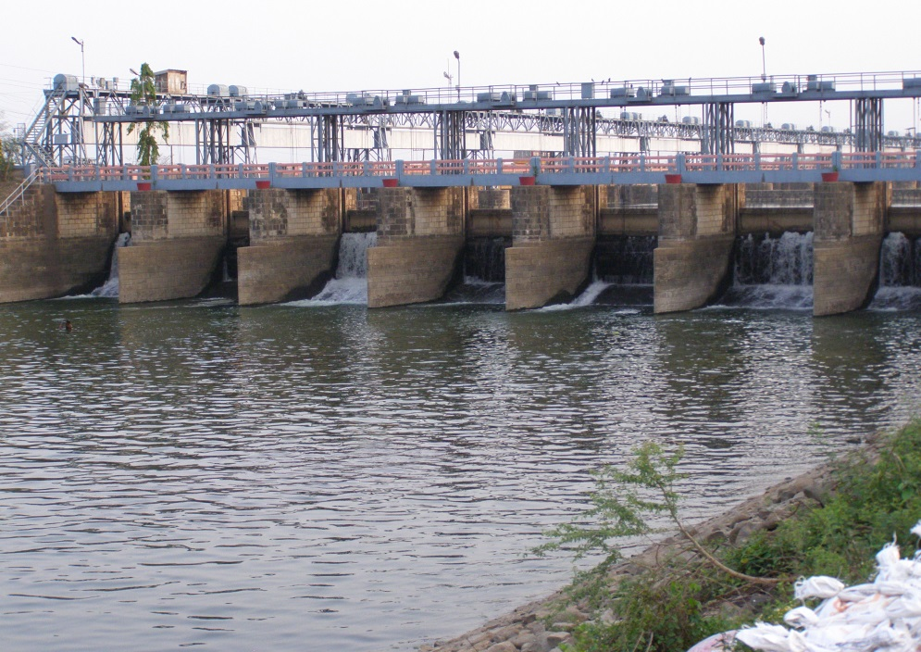
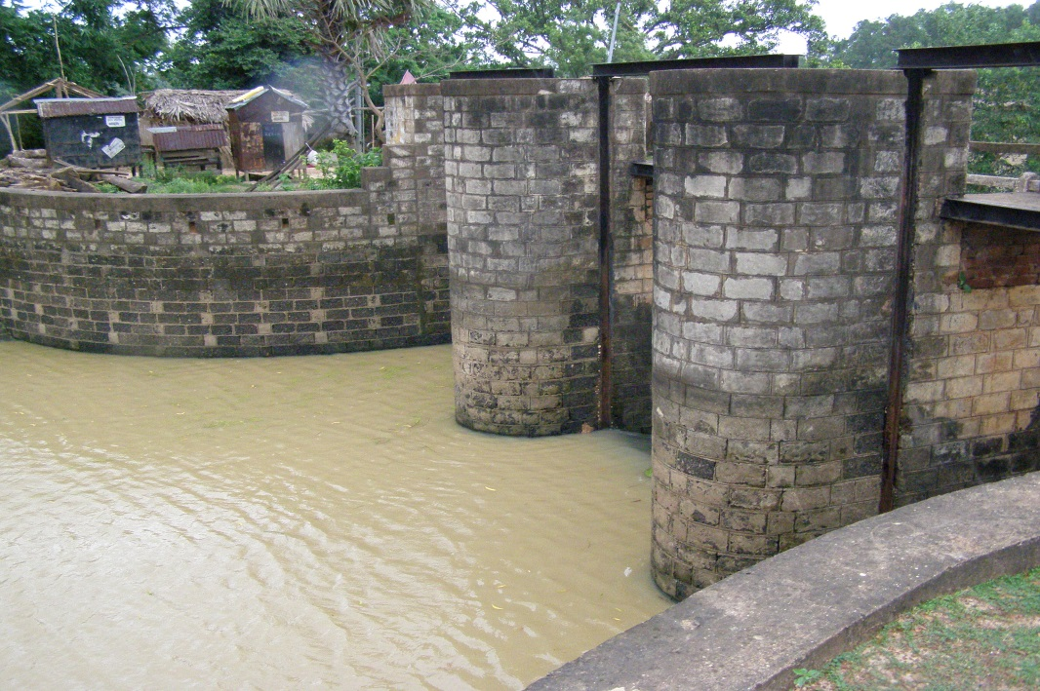
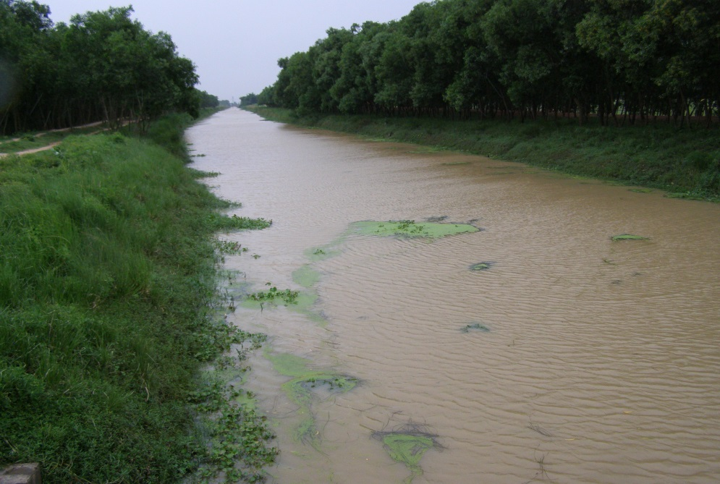
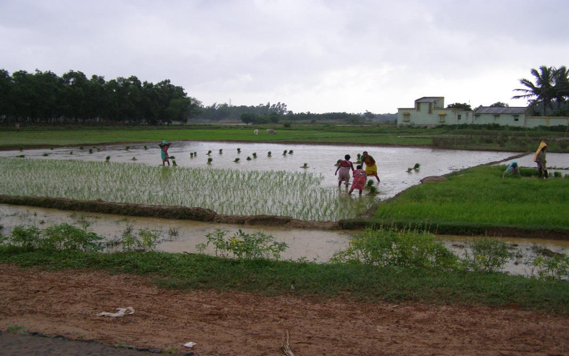
HEAD REGULATOR AT DURGAPUR BARRAGE
NAVIGATION HEAD REGULATOR
LEFT BANK MAIN CANAL
IRRIGATION

Slide 23
MAJOR ISSUES FACED BY DVC
LAND ACQUISITION
REHABILITATION AND RESETTLEMENT
FLOOD OPERATION
LOWER DAMODAR CHANNEL CAPACITIES
OPERATION OF THE TENUGHAT RESERVOIR
ACTIVITIES WITHOUT KNOWLEDGE OF DVC
ENVIRONMENTAL IMPACT
CAPITAL SHARING
FUND
ILLITERACY
POLITICAL WILL
EMPLOYMENT
EXTRACTION OF FULL BENEFITS (TPD ETC)
EROSION & SEDIMENTATION
SHARING OF WATER
TECHNOLOGY
LACK OF PRO-ACTIVE PARTICIPATION OF STAKE HOLDERS

Slide 24
STRATEGIES TO COMBAT ISSUES
FLOOD CUSHION OF TILAIYA AND KONAR RESERVOIR MAY BE USED AS A COMBINED STORAGE FOR FLOOD AND CONSERVATION STORAGE
IF EXTRA WATER IS MADE AVAILABLE, IRRIGATION FACILITIES MAY BE EXTENDED TO JHARKHAND STATE THROUGH KONAR AND TILAIYA RESERVOIRS
IN CASE OF MAITHON AND PANCHET, EXISTING OPERATIONAL CONSERVATION LEVEL MAY BE INCREASED BY 1.52 MT. IN EACH RESERVOIR
ALL M&I WATER ALLOCATIONS MAY BE REVIEWED TO LOCATE SURPLUS IN THE ALLOCATED QUANTITIES
TO COMBAT THE FLOOD AT THE LOWER VALLEY, DOWN-STREAM FLOOD CARRYING CAPACITIES MAY BE REVIEWED AND MEASURES FOR IMPROVEMENT OF CARRYING CAPACITY MAY BE TAKEN
ADEQUATE AFFORESTATION AND SOIL CONSERVATION MEASURES ARE ALSO REQUIRED TO BE TAKEN UP AT THE UPPER VALLEY TO REDUCE THE EROSION RATES
TO TAKE UP RAIN WATER HARVESTING AND GROUND WATER RECHARGING PROJECTS
RENOVATION OF OLD IRRIGATION & WATER SUPPLY CANAL SYSTEM AND IMPLEMENTATION OF MODERN IRRIGATION TECHNIQUES FOR OPTIMUM USE OF THE RESOURCE

Slide 25
STRATEGIES TO COMBAT ISSUES
CONJUNCTIVE USE OF SURFACE AND GROUND WATER
INSTILLING DISCIPLINE IN EQUATABLE DISTRIBUTION THROUGH WATER USERS ASSOCIATION’S PARTICIPATION
IMPLEMENTATION OF MORE SCIENTIFIC CROPPING PATTERN
OPERATION OF CANALS AND DISTRIBUTION NETWORK ON DEMAND BASED RATHER THAN SUPPLY BASED
VOLUMETRIC BASED MEASUREMENT OF WATER AT USER END
REVISION OF WATER TARIFF
TAPPING OF UNHARNESSED HYDRO-POWER POTENTIAL OF NEARLY 3500 MW

Slide 26
CONCLUSION
WELL STRUCTURED LEGAL AND REGULATORY FRAMEWORKS VIZ. DVC ACT 1948, INTER STATE AGREEMENT 1978 AND DVRRC BROADLY COVER ALMOST ALL THE ASPECTS MENTIONED IN DRAFT CWC GUIDE LINES ON IMPLEMENTATION OF IWRM. HOWEVER PRO-ACTIVE PARTICIPATION OF THE STAKE HOLDERS IN MANAGING THE WATER RESOURCES OF THE VALLEY IN EFFICIENT, SPEEDY AND TANGIBLE MANNER IS NEED OF THE HOUR.
SINCE DVC PROJECTS ARE NEARLY 55 YEAR’S OLD, DEDICATED AND SINCERE EFFORTS OF ALL CONCERNED IS HIGHLY REQUIRED TO REJUVENATE THE EXISTING INFRA-STRUCTURE AND TO CREATE ADDITIONAL FACILITIES FOR ACHIEVING THE ORIGINAL PLAN OF DEVELOPMENT.

Slide 27
THANKS

